Slide 1
Blockchain Platforms
COMP6452 Software Architecture for Blockchain Applications
Dilum Bandara
| Research Scientist
| Architecture & Analytics Platforms (AAP) team
| Dilum.Bandara@data61.csiro.au
Notes:
In this class, we’ll discuss several popular blockchain Platforms
We’ll first start with a quick introduction to cryptography.
This will provide us with some background needed to discuss blockchain (BC) implementations
Then we’ll discuss 3 popular BC platforms
Bitcoin and Ethereum are public BCs while Hyperledger is for private or consortium BCs
Under Ethereum we’ll also discuss Smart Contracts (SCs) in more detail

Slide 2

Outline
Cryptography basics
Bitcoin
Ethereum
Smart contract development
Hyperledger

Slide 3
Blockchain
Decentralized trustless environment
Replicated/distributed ledger – Linked list with hash pointers
Based on Public-Key Cryptography & Hashing
Needs to address many distributed system problems
H( )
Genesis Block
of previous block
of previous block
of previous block
H( )
H( )
H( )
Transactions
⁞
Transactions
⁞
Transactions
⁞
Notes:
In the previous class, we talked about BCs goal, which is to replace the central trusted authority with a network of computers such that we establish a decentralised, trustless environment
From an implementation point of view, BC is a replicated or distributed ledger which looks like a linked list with hash pointers distributed over a network of nodes
In the latter part of the last lecture, we also discussed about challenges associated in building a
decentralized & consistent ledger
with the ability to prevent double-spending
high availability
while overcoming challenges such as:
unreliable networks
timing & ordering issues
faulty & misbehaving nodes
Next, we discuss other part of the solution which is Public-Key Cryptography & Hashing

Slide 4
Cryptography Basics
Notes:
In the next couple of slides, we’ll discuss hashing, Merkle trees, and public-key cryptography

Slide 5
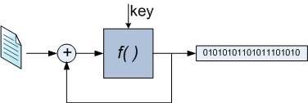
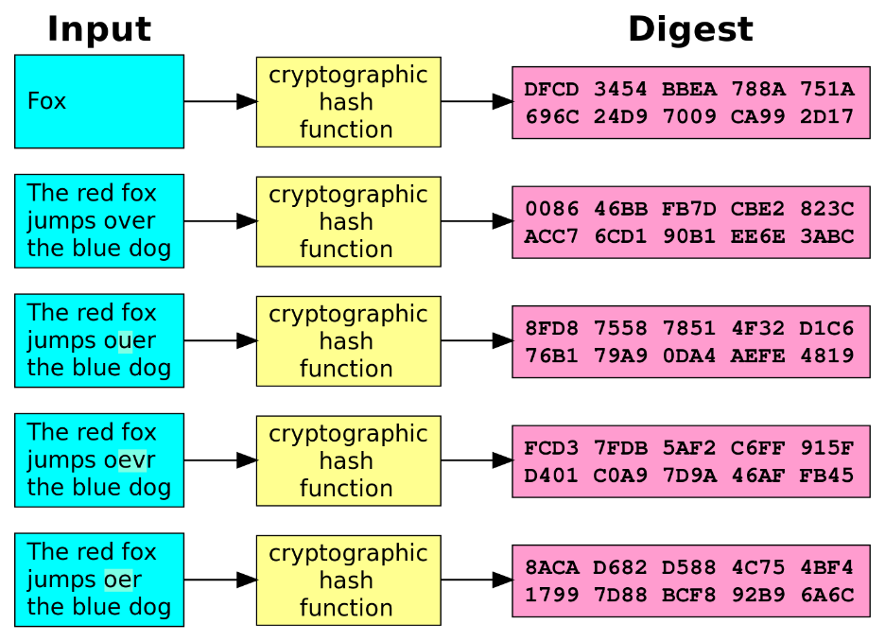
Hashing
Converts a large amount of data into a small datum
Map data of arbitrary size to data of a fixed size
Returned value is called hash value, hash code, digest, or simply hash
Algorithms
MD5, SHA, SHA-3
64, 128, 160, 224, 256, 384 & 512 bits
Input Value Hash value
Some content from https://en.wikipedia.org/wiki/Hash_function &
https://en.wikipedia.org/wiki/Cryptographic_hash_function
Notes:
Hashing is the process of converting a large amount of data into a small datum
In this figure, given a document, we use a special function to derive a small bit string that sort of becomes a fingerprint for the document
We chose this function such that it can capture even a minor change in the document by producing a significantly different bit string from the original bit string
The function can take in arbitrary long input and produce a fix-sized output
Such a function is called a hash function, and the resulting bit string is called the hash, hash value, hash code, or digest
Some of the popular hash functions are MD5 and variants of SHA like SHA2 and SHA3
MD stands for message-digest while SHA stands for Secure Hash Algorithm
The hash value produced by these algorithms can be of various lengths like 64-bit, 128, 160, 224, 256 bits and so on

Slide 6
Properties of Cryptographic Hash Functions
Deterministic
Same message always results in the same hash
A small change to a message change hash value so extensively that old & new hash values appear uncorrelated
Called Consistent Hashing
Quick to compute hash value for any message/document
A one-way function – Infeasible to invert
Infeasible to generate a message from its hash value except by trying all possible messages
Infeasible to find 2 different messages with the same hash value
If happens, it’s called a Hash Collision
Notes:
Let's discuss some properties of hashing
As we can see here, even a minor change in input results in a notable change in output
Some of the properties of Cryptographic Hash Functions include the following:
Hash value is deterministic where same input always results in the same hash
A small change to a message should change the hash value so extensively that the new hash value appears uncorrelated with the old hash value
Such hash functions are called Consistent Hashing
Hash value of a given message or document can be computed fast
However, they are one-way functions. Hence, given a hash we can't derive the corresponding message. So only way to generate a message from its hash value is to try all possible messages
It's practically infeasible to find 2 different messages with the same hash value. If this happens, it’s called a Hash Collision.
Possibility of a hash collision can be reduced by increasing the length of the hash value, e.g., most BCs used hash values of 256 bits or more

Slide 7
Merkle Tree
Binary tree built using the hash function
Allow efficient & secure verification of the contents of large data structures
Can demonstrate a leaf node is a part of a given hash tree in Θ(log n)
H( )
H( )
H( )
H( )
H( )
H( )
H( )
H( )
H( )
H( )
H( )
H( )
H( )
H( )
H(Tx₁)
H(Tx₂)
H(Tx₃)
H(Tx₄)
H(Tx₅)
H(Tx₆)
H(Tx₇)
H(Tx₈)
Notes:
A tree of hashes organized as a binary tree is called Merkle Tree
In the context of BCs, leaves of the tree are transactions (TXs)
Then we concatenate 2 TXs and compute their hash. Then we concatenate 2 hashes and calculate another hash. We continue this process until we reach the root of the tree
If we have n TXs height of the tree is log2(n)
A Merkle Tree is a way of efficiently & securely verifying the contents of large collection of data. In BCs, it is used to summarize the set of TXs included in a block. So even if a single TX changes, root hash will change.
Also, in BCs, we can verify whether a TX is included in a block using the Merkle Tree. Given a TX and hashes of its adjacent and parent hashes, we can verify whether the same root hash is produced in Θ(log n) time

Slide 8
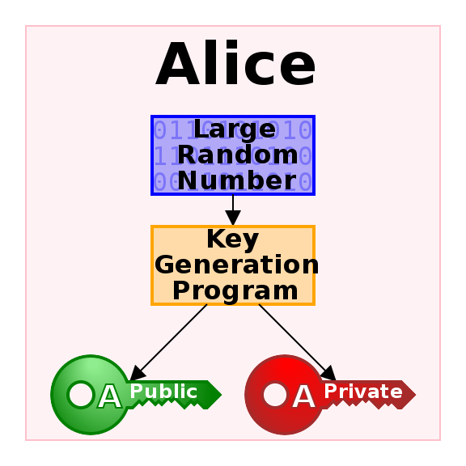
Public-Key Cryptography
Aka., asymmetric cryptography, is a cryptographic system that uses pairs of keys:
Public keys – May be disseminated widely
Private keys – Known only to the owner
Effective security only requires keeping the private key private
Easy to create new key pairs
Algorithms – RSA, ECC
128, 256, 384, 512, 1024, 4096 bits
Used heavily in blockchain
Losing your private key can mean loss of assets
If hackers can get your private key, they can steal your assets
Some content from https://en.wikipedia.org/wiki/Public-key_cryptography
Notes:
Public-Key Cryptography is the foundation for digital signatures in BCs
It's also called asymmetric cryptography, as it is a cryptographic system that uses pairs of keys:
One of the keys is called the Public keys and expected to be disseminated widely
Other key is called Private keys and expected to be known only to the owner
Owner of a private key needs to keep it private to achieve security
It's easy to create new key pairs using algorithms such as RSA and ECC (Elliptic curve cryptography).
These algorithms rely on large number numbers as a seed and generate a key pair
Typical key lengths are 128, 256, 384, 512, 1024, 2048, 4096 bits.
With RSA we use key lengths over 2048 today while ECC keys are relatively smaller as they are more effective. For e.g., 384-bit ECC has similar strength as 4096-bit RSA key
In BCs, Public-Key Cryptography is used to indicate the ownership of assets and authentication to spend them
For e.g., when Alice send $300 to Bob, she needs to sign her TX using her private key
If Alice lose her private key, it same as she loses control of her assets

Slide 9
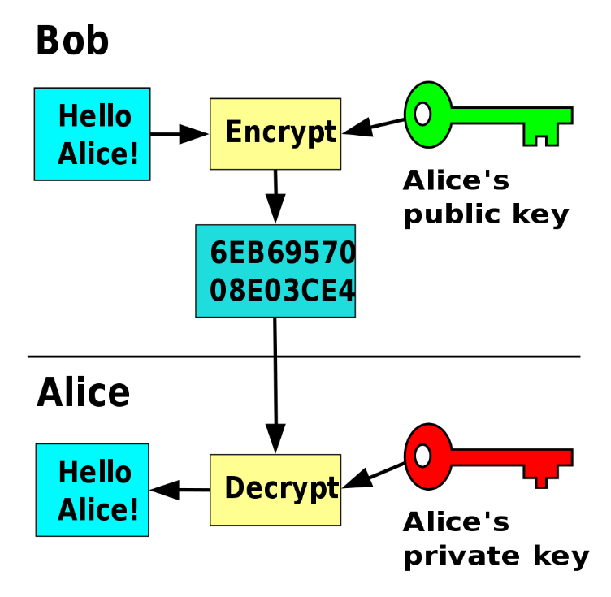
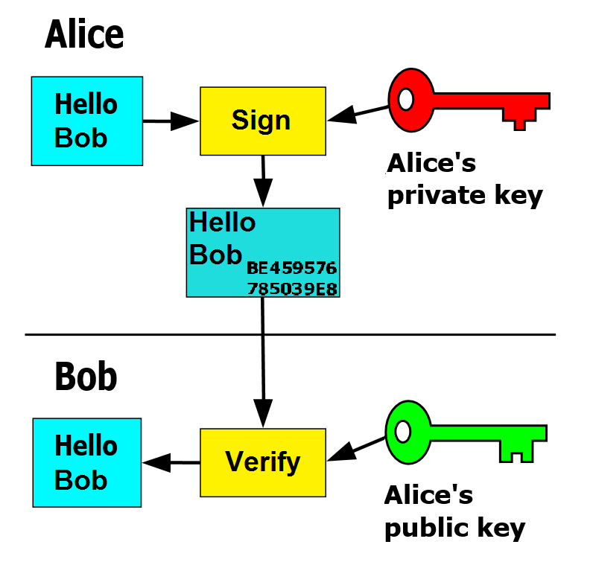
Encryption & Digital Signatures
Only Alice can decrypt the message
No-one can change the message without breaking Alice‘s signature
Provides autentication
Some content from https://en.wikipedia.org/wiki/Public-key_cryptography
Notes:
Public-Key Cryptography serves 2 purposes, where it can be used for encryption and digital signatures
On the left, Bob wants a send a secret message to Alice. So he encrypts the message using Alice's public key, which is well known. However, to decrypt the message Alice needs to use her private key. As Alice is the only one who knows the private key, no one can read the message other than Alice
Whereas in digital signatures the use of key pairs is reversed
In this case, Alice wants to prove that she is the one who signed the message. So the message is signed with Alice's private key and Bob can verify it using her public key. No one else can impersonate Alice unless they know her private key
In practice what is signed is a datum or hash of the message, which is not shown in the diagram to keep it simple

Slide 10
Public-Key Cryptography in Use in Blockchain
Control over accounts using private key
Control means the ability to act on behalf of the account
E.g., spending the assets it owns
Each account is known by its public key
“Alice” here is really 0x7a2f16dab8b5c2cf99c35e4c6a5beb45c7df8f87
For some accounts, we may know the person/organization owning it
But by default, we don‘t
Some content from https://en.wikipedia.org/wiki/Public-key_cryptography
Notes:
Here we talk about the specific use of public-key cryptography in BCs
Ownership of an account in BC is proven using the private key
Whereas each account is known based on its public key. For e.g., Alice's account is represented as a bit string like this
In practice, an account is Ethereum is derived from a 256-bit public key and reduce to 160-bit address for convenience
Whereas private key is 256-bits
For some accounts, we may know the person/organization owning it. But by default, we don‘t know. In fact, in Bitcoin it's even recommended to create a new account for each new transaction such that you can achieve some-level of anonymity

Slide 11
Bitcoin

Slide 12

Bitcoin
First cryptocurrency (BTC) built on the idea of a blockchain
2018 white paper by Satoshi Nakamoto – Paper never used the word “blockchain”
Implementation in Jan. 2009
Blockchain keeps track of the ownership of portions of that currency
Time between blocks, called inter-block time, is on average 10-min
But variation of times is high
Notes:
Bitcoin is the 1st cryptocurrency built on the idea of a BC. Both BC and currency are called Bitcoin and the symbol is BTC
It was proposed in a 2018 white paper by a pseudonym called Satoshi Nakamoto. Interestingly paper never used the word “blockchain”.
Implementation appeared in Jan. 2009
Bitcoin BC keeps track of the ownership of portions of that cryptocurrency
Bitcoin follow the linked-list structure we discussed earlier.
Time between 2 blocks is called inter-block time.
Average inter-block time is 10-min. However, it changes widely from a couple of minutes to 20 to 30 min

Slide 13
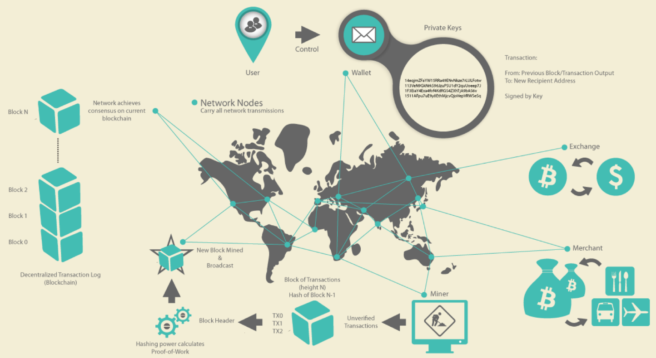
Blockchain 1st gen — Cryptocurrency
Users:
Create TXs,
Sign them
Announce them to network
Miners:
Receive TXs
Include them in a new block
(try to) append new block to the chain of blocks
When a TX is part of the data structure, it has taken place
Exchanges:
Users can trade bitcoin with other currencies
Send 2 BTC from my account to Bob.
Signed: Alice
Source: Andreas M.Antonopoulos, Mastering Bitcoin-Unlocking Digital Cryptocurrencies
Notes:
Bitcoin ecosystem consists of 3 roles, namely users, miners, and exchanges
Users create TXs, sign them, & announce them to Bitcoin network
Miners receive TXs, include them in a new block, & try to append new block to the chain of blocks
Exchanges are used to trade bitcoin with other fiat and cryptocurrencies

Slide 14
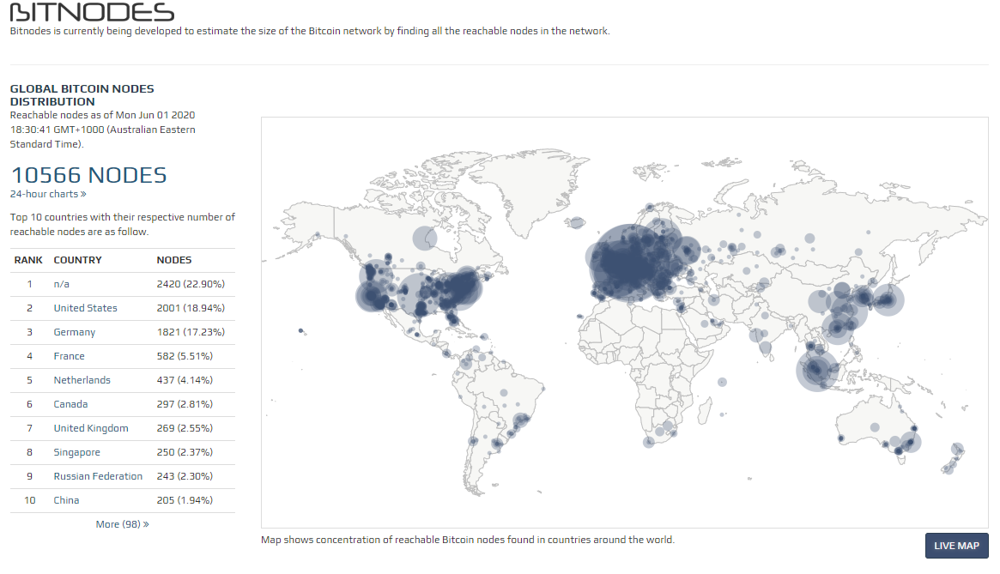
Bitcoin Network Distribution
Source: http://bitnodes.21.co
Notes:
This is a visualisation of the node distribution in Bitcoin network.
We can go this website to see more recent details
As per the statistics collected a few min ago, there are ~10K nodes in the network.
These are the locations when it can be estimated. So for a large portion of nodes we don't know the location.
If can get bit more details on the live map
Go to this website & explore a bit. This is the current block no, no of reachable nodes, & their versions
ASNs - Autonomous System number which is an indication of the ISPs

Slide 15
Accounts & States
An account is associated with a cryptographic key pair
Public key – Used to create the address of an account
Private key – Sign TXs sent from the account
State of the blockchain
Account balances of all users
Result from the genesis block (very 1st block) & the set of TXs included since
Some accounts might be pre-loaded with an initial account balance at genesis
As TXs are grouped into blocks, the entire system moves from one discrete state to another through addition of a new block
Notes:
Let's discuss a few definitions which can be generalized to more other BCs too
A bitcoin account is associated with a cryptographic key pair
Public key is used to create the address of an account
Private key is used to sign TXs sent from the account
Account balance is the sum of UTXOs that an account has control over
Each UTXO is bind to owner’s public key
State of the BC is the account balances of all users. This is also referred to as the Global state
It captures results from the genesis block (very 1st block) & set of TXs included since
Some accounts might be pre-loaded with an initial account balance at the genesis
As TXs are grouped into blocks, the entire system moves from one discrete state to another through creation of a new block

Slide 16
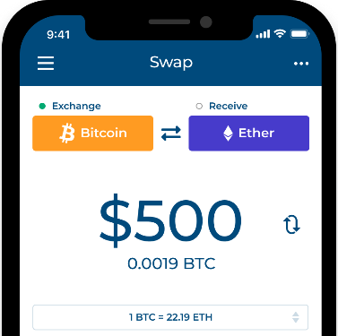
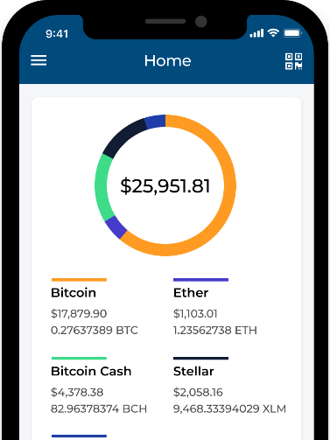
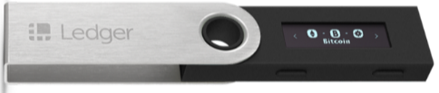

Wallets & Exchanges
Wallets
Software wallet that manages a collection of private keys of accounts
Hardware wallets are devices that store private keys in chips
Cold storage backups – To avoid key loss, a representation of the keys are stored independent of the user’s current hardware wallets
Create & sign TXs
Exchanges
Places to trade cryptocurrencies with other currencies (both fiat & crypto)
Key stakeholders for public blockchain
Holds currency on behalf of users
Users may ask the exchange to transfer purchased currencies to an address under their control
If an exchange fails, its users may lose control of “their” cryptocurrencies
Source: https://blockchain.com
Source: ledger.com & trezor.io
Notes:
2 other terms related to BCs are the Wallets & Exchanges
A wallet, aka digital, crypto, or software wallet is where keep track of your assets.
In a physical wallet we keep our notes and coins. We also keep credit and debit cards that provide access to our money.
Similarity, in a software wallet we manage a collection of private keys of our accounts
There are hardware wallets that store private keys in chips
To avoid key loss, a representation of the keys is stored independent of the user’s current hardware wallets. These are called Cold storage backups
Usually a wallet is used to create & sign TXs
Like currency exchanges, cryptocurrency exchanges are the places to trade cryptocurrencies with other currencies (both fiat & crypto). They are an essential element of cryptocurrencies
These could also hold currency on behalf of users. In such cases they are called custodian wallets
Users may ask the exchange to transfer purchased currencies to an address under their control
If an exchange fails, its users may lose control of “their” cryptocurrencies. This is particularly true when exchanges act as custodian wallets.
There are also decentralized exchanges that does only match a cryptocurrency buy and sell order and don't hold any keys

Slide 17
Transactions
Transfer currency from source addresses to destination addresses
Contains 1+ inputs & 1+ outputs
If sum of the outputs is less than sum of the inputs, the difference is a fee to the miner
TX fee is an incentive for miners to contribute computing power & storage
A TX contains proof of ownership for each input, in the form of a digital signature of the owner
TX output is bind to owner’s public key
Notes:
Bitcoin TXs have an interesting structure and used to transfer Bitcoins from source addresses to destination addresses
A TX contains one or more inputs & one or more outputs. For e.g., this TX has 1 input and 2 outputs
Each of those outputs can be spend later in another TX
Difference between input & output values is taken as the TX fee by the miner. For e.g., here 100,000 Satoshis 100K comes in. A Satoshi is like a cent. Total value of outputs is 90K. Remaining 10K is the TX fee for this TX
These TX fees are incentive for miners to contribute computing power & storage
A TX contains proof of ownership for each input, in the form of a digital signature of the owner

Slide 18
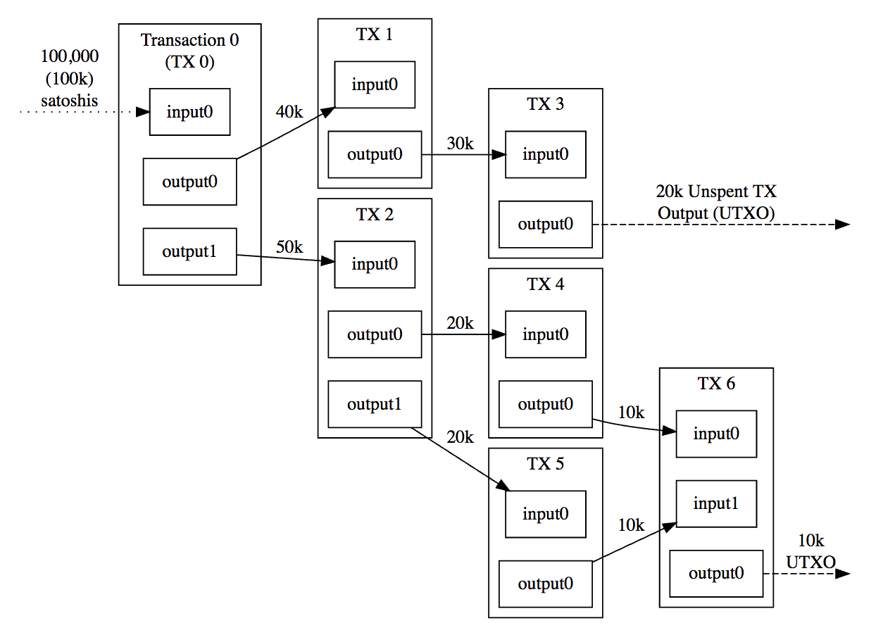
Transaction Format
Linked TXs
Outputs of TXs become inputs of a new TX
Bitcoin addresses don’t contain “coins” balance
Store Unspent Transaction Outputs (UTXO)
Balance of an address/account
Sum of all of the values of UTXOs associated with the address
State of the blockchain
All the UTXOs in system
Notes:
Bitcoin TXs are linked where output of one TX becomes the input to another TX
However, compared to a typical account and balance maintained by a bank, Bitcoin addresses don’t contain “coins”
Instead these unspent outputs are called UTXO
A UTXO can be spent only once
So if you want to find how much bitcoins you own, you need to sum all UTXOs associated with your address
Also, Bit“coin” is misleading, as fractional ownership, e.g., 1.64 BTC, is the norm. For e.g., satoshi is the smallest unit of BTC and it's a one 100 millionth of a single Bitcoin (0.00000001 BTC)

Slide 19
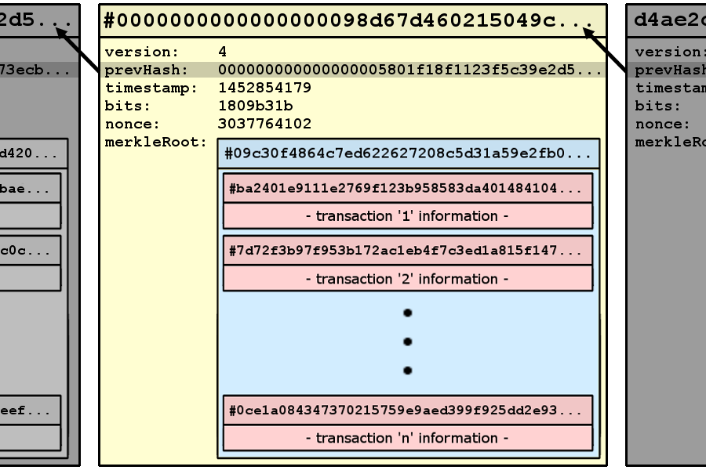
Blocks
A container of TXs
Identified by block hash
Linked to previous block
Includes a timestamp
Not very accurate
Include a nonce
Proof of ability to produce the block
Use a Merkel tree to capture ordered list of TXs
Max block size of 1 MB
Source: https://blog.scottlogic.com/2016/04/04/ jenny-from-the-blockchain.html
Notes:
As discussed earlier a block is a container of TXs
A block is identified by block hash
In this figure this is the block hash. It links to previous block using its hash
While block includes a timestamp, it's not very accurate. Due to clock drift, minors can set any timestamp within a certain window. Usually this window can be as high as 2 hours
A block also includes a nonce, which used to as a proof of ability to produce the block
Then the ordered list of TXs are captured using a Merkel tree
Max block size in Bitcoin is 1 MB

Slide 20
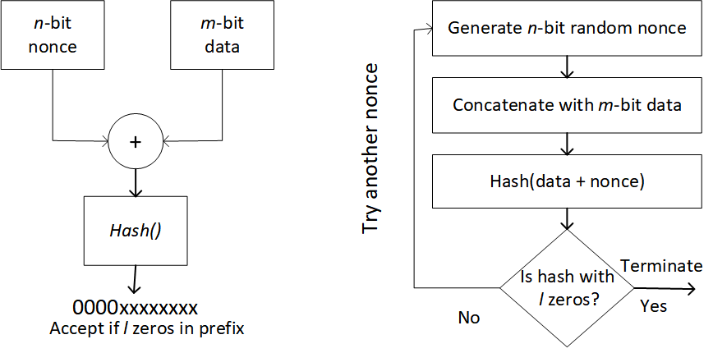
Right to Build a Block – Mining
Miners compete to create new blocks by solving hash puzzles
Proof-of-Work (PoW) based on hashcash
Embracingly parallel problem with no shortcuts
Try nonce values until you get lucky
Difficult to compute, easy to validate
Acceptance threshold is adjusted over time to ensure ave. inter-block time remains 10-min with increasing computing power
New BTCs are rewarded to the miner who create a valid block
Reward halved every 210,000 blocks
12.5 BTC reward since 2016 became 6.25 BTC in May 2020 (initially, 50 BTC)
Notes:
Let's discuss a bit about the mining process in Bitcoin
Once a set of pending TXs are include in a block, miners need to solve a puzzle to build a block.
The miner who solves this puzzle 1st is considered to has the right to build the block.
Bitcoin miners solve a puzzle called hashcash to build a valid block.
Solving this puzzle is called Proof of Work (PoW) as it is difficult (costly, time-consuming) to solve but easy for others to verify. This is more like you solve a problem spending hour, while your teacher can verify your answer in seconds
PoW algorithms like hashcash are embracingly parallel problems with no shortcuts
Here's a diagram that outlines the basic idea
On one side you have the data that reflect the content of the header like Merkel root, previous hash, and timestamp. On the other hand, you have the nonce
You concatenate the 2 and calculate the hash and see whether the resulting hash value satisfy a certain properly. For e.g., here we check whether the hash has 4 zeros as prefix. Such a hash is called a valid hash and the associate block is called a valid block.
If not, you must retry again while changing the nonce. You can't change the m-bit data, as it reflects the content of the block
Here's the process as a flow diagram. First get a n-bit nonce, concatenate with m-bit data, hash, and check for the condition. If not satisfied repeat the process again
There's no easy way to guess what nonce would work. So you must try nonce values until you get lucky
While it's difficult to find what nonce work, easy to validate whether a give nonce satisfy the condition
In practice acceptance threshold can be more specific like a very large number. Acceptance threshold is adjusted over time to ensure average inter-block time remains 10-min with increasing computing power
New Bitcoins are rewarded to the miner who create a valid block. In Bitcoin nonce is 32-bits and resulting hash value is 256-bits. Hence, a quite a massive number of hashes need to be tried make it power hungry.
However, the reward halved every 210,000 blocks and on May 11, 2020 it became 6.25 BTC (initially, 50 BTC)

Slide 21
Mining (Cont.)
Receiving a new block
End of one round is the beginning of the next round
Aggregation
Remove TXs of the newly announced block from TX pool
Aggregate subset of the remaining valid TXs
Add coinbase TX as the 1st TX to the TX list for the next block
Header Construction
Calculate/include the hash of the previous block
Construct a Merkle tree to summarize all the included TXs
Solving puzzle
Find solution to PoW algorithm
Result will be inserted to the block header, if successful
Propagation
Immediately propagate new block to other nodes
Notes:
This diagram shows the overall mining process.
Once a new valid block is built and propagated to other nodes in the network, miners start building the next block while using the new block's hash as the previous hash
First, they remove TXs of the newly announced block from pool of pending TXs.
Aggregate subset of the remaining valid TXs
Then add Coinbase TX as the 1st TX to the TX list for the next block. Coinbase TX is used to claim the block generation reword
Next, build the header by including the hash of the previous block and Merkle tree to summarize all the included TXs
Find solution to the PoW algorithm. If successful result (in this case nonce) is inserted to the block header
Finally, successful miner immediately propagates new block to other nodes

Slide 22
Who can Build a Block?
Miners might find & announce next blocks at the same time
Treat the longest history of blocks as the main chain
One that received most computation
Referred to as Nakamoto Consensus
Fork in the blockchain
Fork decided: longer chain wins
Notes:
Finding a valid block doesn't mean the block is finalized. Even the block reword is not guaranteed
Multiple miners might find & announce next blocks at the same time. Hence, we need a tie breaker
Nakamoto proposed the tie breaker based on the longest history of blocks and claimed it the main chain. Longest chain is also the one that received the most computation
For e.g., block n has 2 successors. Then the subsequent blocks built while using these successors as the previous block.
Eventually, one of the forked chains will be longer than others. In this case, the bottom chain will be accepted as the longer chain.
Top block n+1 is dropped and all its TXs go back to the TX pool to be included in a block in the future
This approach of deciding what blocks are considered as finalized is called Nakamoto Consensus

Slide 23
Nakamoto Consensus
To determine with high probability that a TX is permanently included:
Wait for several blocks (6 blocks by default) to be added after 1st inclusion of the TX in a block
Each of these subsequent blocks is called a confirmation block
Once sufficiently many confirmations occurred after the TX block inclusion, then the TX is considered committed
Unlike many traditional TX commit semantics:
Commit only has a probabilistic guarantee
Doesn’t fully comply with ACID properties
A longer chain could appear – although it may be very, very unlikely
Notes:
Let's talk a bit about Nakamoto Consensus
To determine with high probability that a block and its TX are permanently included, we need to wait for several new blocks to be added after the 1st inclusion of the TX in a block
This way, we can give enough time for any forks to get resolved. Again here we are not talking about physical time, but the need to wait for an enough new block
In Bitcoin, we assume that it is enough to wait for 6 blocks once a TX is included in a block. 6-blocks are approximately 1 hour. This number is determined based on a probabilistic analysis
Each of these subsequent blocks is called a confirmation block. Once sufficiently many confirmations occurred after the TX is included in a block, then the TX is considered committed
However, compared to traditional database-like TX commit semantics:
Commit only has a probabilistic guarantee
Doesn’t fully comply with ACID properties
A longer chain could appear – although it may be very, very unlikely
In practice TXs need to be fast, persistent, & low cost to be useful

Slide 24
Question
Which of the following statement(s) is True?
As the number of ledger copies increases, it becomes difficult to maintain the consistency of the ledger
Given a hash value, we can derive the corresponding message
An attacker can fabricate a TX using Alice’s public key to show that Alice is engaged in illicit TXs (e.g., money laundering)
As soon as a Bitcoin TX is included in a block, it is safe to assume the TX is final (e.g., Charlie can ship a bicycle to Alice)
✓
X
X
X

Slide 25
Ethereum
Notes:
Next, we discuss about Ethereum.
Ethereum design has many similarities to Bitcoin. Hence, we will focus most of the differences between the 2 designs

Slide 26

Ethereum
2nd generation PoW blockchain with Nakamoto consensus
Native currency is Ether (ETH)
Can deploy & execute programs known as Smart Contracts
Ledgers that can store/transact any kind of data
Ethash is both CPU & Memory intensive
Eliminate use of ASIC
Smaller blocks with inter-block time of 13-15 sec
Max block size is ~10,000,000 gas → Limits computational complexity of TXs
Max 476 TXs in a block (Bitcoin 1,500 TXs/block), most blocks under 2KB (Bitcoin 1 MB)
Notes:
As Ethereum supports fully flood SCs, it's considered a 2nd generation PoW BC with Nakamoto consensus
Even Bitcoin supports a limited set of SC features. However, it's Ethereum that demonstrated the true power of SCs
With the introduction of SCs, Ethereum ledger can store/transact any kind of data
Ethereum also use PoW with an algorithm called Ethash. Key difference between Ethash and Hashcash is that it's also memory intensive making is difficult to solve the puzzle with hardware optimizations such as ASICs (Application-specific integrated circuit)
TXs fees are defined as Gas, which is a unit that reflects the computational complexity, bandwidth use, & storage needed to execute a certain Assembly-level instruction
Ethereum blocks are relatively small and inter-block time is 13-15 sec
Current max block size is around 10,000,000 gas. This limit computational complexity of TXs included in a block
Hence, we can include only a maximum of 475 TXs in a block. Whereas in Bitcoin we can include ~1,500 TXs/block.
Therefore, Ethereum blocks are small and typically under 2KB (Bitcoin 1 MB)

Slide 27

Paying Fees in “Gas”
Gas
Unit that reflects the computational complexity, bandwidth use, & storage needed to execute a certain operation/instruction
A fee to limit the resource usage
Gas cost/limit
A fixed gas cost per TX (base cost of 21,000 gas)
Variable gas cost for data (dependent on size) & execution of a SC method (charged per bytecode instruction)
Additional gas cost for the deployment of new contracts
Gas price
Gas price reflects how much ether per gas the TX sender is willing to pay
Clients need set the gas price to a market price
Set higher gas price if inclusion of TX is urgent
Or lower gas price if TX inclusion is not (time) critical
Gas price recommendations available e.g., from ETH Gas Station https://ethgasstation.info/
Notes:
Let’s now discuss a bit about TX fees
TXs fees are defined as Gas, which is a unit that reflects the computational complexity, bandwidth use, & storage needed to execute a certain Assembly-level instruction
Gas is a fee to limit the resource usage on the Ethereum network.
Offered TX fee consists of 2 parts, a gas limit and gas price
This’s also useful for the SC user, particularly to guard against errors such as infinite loops where bad code could quickly exhaust our Ether.
However, if we set a low limit, we run the risk of exceeding the gas limit before our code finish execution. Anyway, we don’t want to set a very high limit as Ethereum nodes don’t also like excessively gas-consuming TXs due to the risk of denial service attacks
Gas cost is how much gas we consume.
There is a fixed gas cost for a basic cryptocurrency TX. This is aka, base cost and currently set to 21,000 units
If your TX include data or execute a SC method, then you must pay additional gas in proportion to the size of data or complexity of bytecode instructions that are executed by the SC
Further, additional gas cost needs to be paid for the deployment of new contracts
We can estimate how much gas a SC-related TX may consume. However, in practice, we set a slightly higher gas limit to accommodate any unforeseen changes in the size of data or code behaviour
Gas price is the fee we are willing to pay for a single unit of gas.
While this at the user’s discretion, if you offer to pay a much lower value compared to the market price, your TX could get delayed or even get dropped. Alternatively, you could increase the change of including TX faster by offering to pay a higher gas price
Gas price is dynamic and reflects the number of pending TXs. Some recommendations are available, e.g., from ETH Gas Station https://ethgasstation.info/
1 Billion Gwei is 1 ETH

Slide 28
Ethereum Protocol
Ethereum’s inter-block time > block propagation time around the globe
Bitcoin inter-block time >> block propagation time around the globe
Multiple competing blocks are more likely to be created at a similar time
GHOST (Greedy Heaviest Observed Subtree) protocol
The heaviest chain wins & uncles contribute to the weight
Miners of uncle blocks receive 87.5% of a standard block reward
For every uncle included in the block, miner gains an additional 3.125% & increases the weight of the chain including the block
Notes:
Small blocks also help Ethereum to achieve short inter-block time, as they can be propagated to other BC nodes much faster
Still Ethereum's inter-block time is much smaller compared to Bitcoin. Therefore, it is quite likely that multiple competing valid blocks are created at the same time
To overcome this problem Ethereum uses a protocol called GHOST (Greedy Heaviest Observed Subtree)
In this figure, block n+1 build by miners B and C are competing blocks. These are called uncle blocks.
As per GHOST protocol, rather than the longest chain, the ’heaviest’ chain wins.
The weight is determined based on the number of uncle blocks attached to a block. In this case, miner C's block has an uncle while none for miner B's block.
Uncle - a child of a parent of a parent of a block that is not the parent
Hence, block build by B is eventually discarded when the other chain is getting longer.
Miners reference uncle blocks to add weight to their chain. This recognition is backed by a strong financial incentive mechanism, for e.g., miners of uncle blocks receive 87.5% of a standard block reward. For every included uncle, the miner gains an additional 3.125%
Uncles are the red blocks on ethviewer.

Slide 29
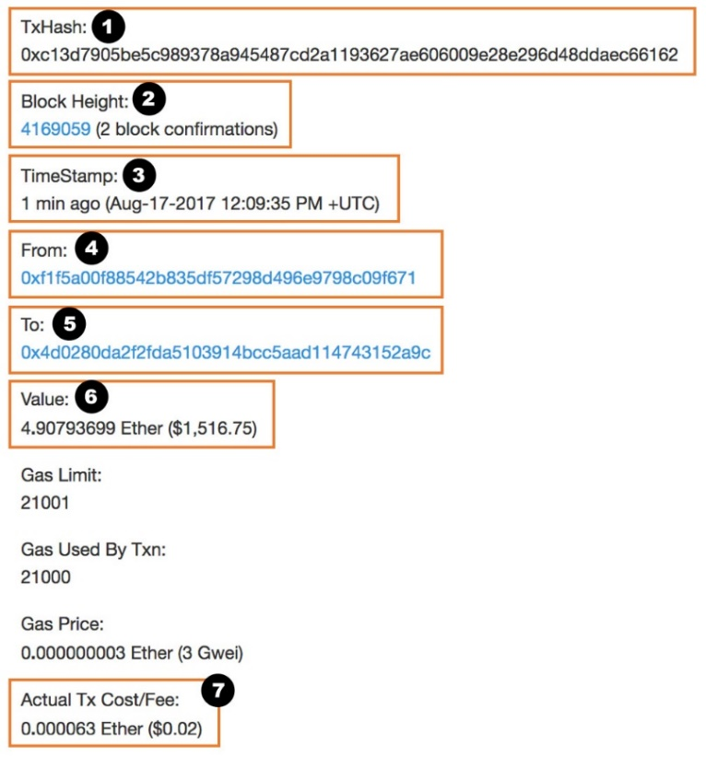
Accounts & Transaction
Uses account-balance model
An account is bind to owner’s public key
A TX is uniquely identified by its hash
TXs are sequenced using a nonce
Once included in a block, block no, actual gas used, actual fee, etc., are available
From – Source address (regular account)
To – Destination address (regular account or contract address)
Value – Ether (in unit “wei”) to transfer to destination (can be 0)
Nonce – TX sequence no for source account
Gas price – price you are offering to pay (Ether per gas)
Gas limit – Max amount of gas allowed for TX
Data – Payload data (TX memo, binary code, or function invocation)
Digital signature (field names: v, r, s)
Notes:
While bitcoin uses UTXO, Ethereum uses a typical account-balance model where the ledger maintains the balance of an account
An account is bind to the owner’s public key and a TX is uniquely identified by its hash
TXs from the same account are ordered by a sequence number called nonce. This nonce doesn’t have anything to do with the nonce in a block
As we saw with Etherscan a TX has a hash, from & to address, nonce, value or data, & a TX fee
In Ethereum, TX fee has 2 parts, a gas limit and a gas price
Gas limit - is the maximum amount of gas the TX issue is willing to spend
Gas price - is the amount of Ether the TX owner is willing to pay for a unit of gas
Once included in a block, block no, actual gas used, actual fee, etc., are available

Slide 30
Transactions Lifecycle
Notes:
This is a state diagram of the lifecycle of a TX
As soon as a TX is submitted to the BC, it is validated by the receiving node.
If valid, TX enters the pool of pending TXs. If not, TX is dropped
When a valid TX is included in a block, it moves to Tx in block(s) state
If the desired number of new blocks are built after this, the TX is committed. While Bitcoin assumes a TX is finalised after 6 new blocks, in Ethereum we wait for about 12 blocks (approximately 3 min)
However, if the BC forks and the block with the TX isn’t included in the longest (or heaviest) chain, block is discarded and all the TXs in the block are send back to the TX pool
While waiting in the pool, a TX may get dropped too. This could happen when the pending list of TXs are too long or TX waited in the pool for a long time without being included in a block. These parameters are BC platform-specific and under the discretion of the miner.
Typically, miners prefer to include TXs willing to pay a high TX fee. Hence, when the TX pool is tool full, minors 1st drop TXs with a low TX fee. Also, miners may even define a minimum TX fee to be included in the TX pool
A dropped TXs may be resubmitted with the same or higher TX fee.
While a TX is pending in the pool, another TX can be submitted with a higher a TX fee and same nonce to replace the existing TX. In that case, the original TX becomes outdates
In practice, few other complex scenarios could determine the lifecycle of a TX. However, this figure is abstract enough for the content of this class

Slide 31
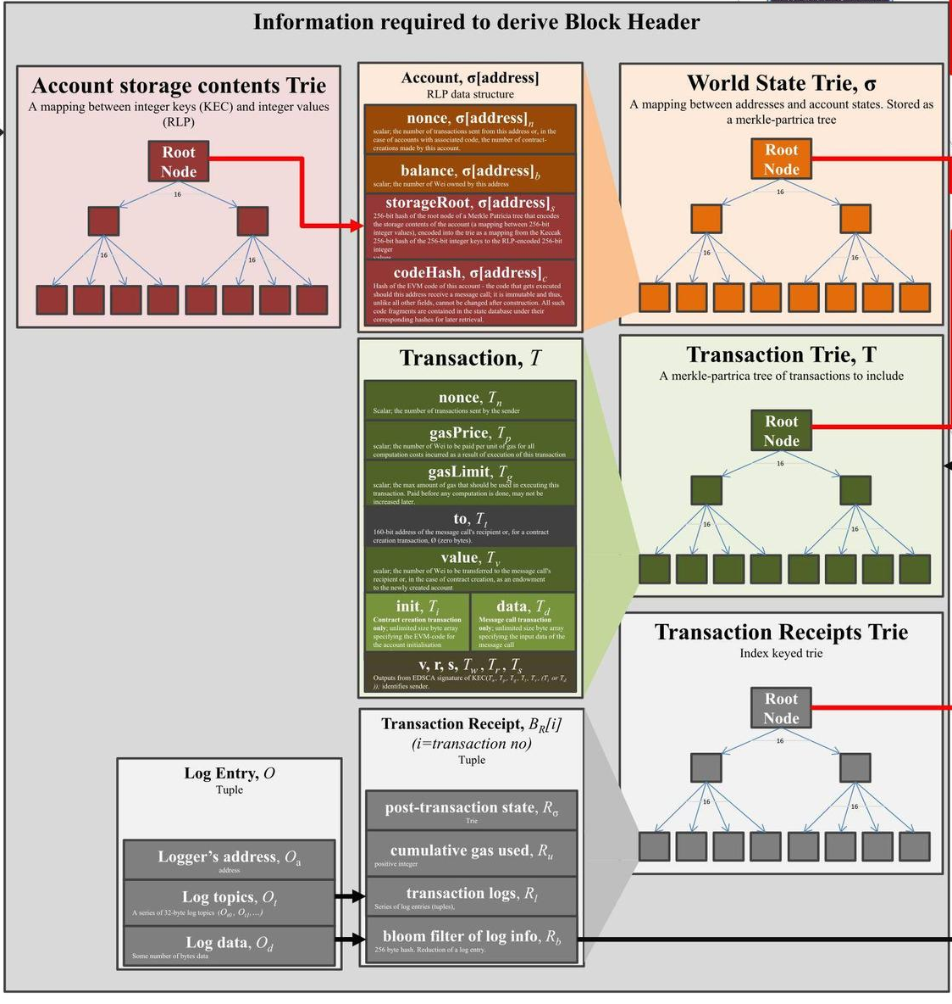
Block Format
Maintain state of all accounts
Aka., World/Global State
Include account balances, data stored, & smart contracts
List of TXs
List of TX receipts (i.e., effects of TXs)
Ethereum uses 3 Merkle trees (known as Trie), one each for integrity of:
World State
TXs
TX Receipts
Source: https://ethereum.stackexchange.com/questions/268/ ethereum-block-architecture
Notes:
Let’s talk about block format in Ethereum
This diagram shows the key data required to build a block in Ethereum. It’s a lot more complicated than Bitcoin
Merkel tree implementation in Ethereum is called Trie
All the balances of accounts are also tracked using a Merkel tree. The list of all accounts & their balances is called the global state or world state
In addition to the list of TXs and the corresponding Merkel tree, an Ethereum block keeps track of the results of TXs. These are called the TXs receipts and they reflect changes in ledger state
Even SC code and their data are treated as assets or balance of an account
Each of these data is captured in a block as the root of the respective Merkel tree

Slide 32
Smart Contracts (SCs)
Blockchain can be a computational platform (more than a distributed database)
User-defined code, deployed on & executed by whole network
Can hold & transfer digital assets, managed by the contract itself
Code is deterministic & immutable once deployed
Execution is triggered via a TX
Aka., a message call
A smart contract can invoke other smart contracts
Notes:
Let’s talk about SCs in bit more details
Among the 4 functions of BCs, SCs use the BC as a computational platform
SCs are user-defined code, deployed on & executed by the whole BC network
A SC can hold & transfer digital assets, managed by the contract itself
Code is deterministic & immutable once deployed
Execution is triggered via a TX. In Ethereum a TX used to trigger a function on a SC is called a message call
A SC can also invoke other SCs

Slide 33
Smart Contracts in General
Analogy – Java program
SC code – a class
Deployed contract – an object
Code is deterministic
Same state/inputs result in the same state changes/outputs
However, state may not be deterministic from viewpoint of the caller
Many software design patterns still apply, e.g., Factory
Why can SC execution be trustworthy?
A contract is deployed as data in a TX & thus immutable
All inputs are through TXs & the current state
Code is deterministic
Notes:
SCs reflect the object-oriented paradigm like in Java
For e.g., SC code is like a class and deployed contract is an object. So when we say SC, we typically refer to the deployed contract
While the code is deterministic where the same inputs result in the same state outputs, it may not be deterministic from the viewpoint of the caller. For e.g., other TXs may get executed before a given caller’s TX changing the input state
Many software design patterns still apply, e.g., Factory
We can consider SC execution be trustworthy due to the factors such as immutability & transparency:
A contract is deployed as data in a TX; hence, same immutability property applies
All inputs are only through TXs & the current state
Code is deterministic
Results of TXs (including function calls) are captured in the State & Receipt Merkel trees, which are part of the consensus

Slide 34
Smart Contract Interactions
SC creation TX – deployment
“To” address is set to Null
After included, identified by a SC address
A SC account contains
A piece of executable code
A storage to store internal state
An amount of Ether, i.e., contract balance
Monetary TX
Can receive, hold, & spend assets, like Ether
Assets held by the account address are controlled by executable code
Invoking TX contains
Interface of the function being invoked & its parameters in the data payload
Invoked function may call 1 or more functions in other smart contracts
Notes:
As shown in the figure, there are 3 types of SC-related TXs.
First, a SC needs to be created or deployed on to the BC using a contract creation TX.
The data filed of the TX contains the code of the SC
Once a SC is included in a block, it can be identified by an address, that’s referred to as SC address
A SC account contains an executable code, storage to store internal state, and crypto balance (e.g., amount of Ether)
Users can transfer cryptocurrency such as Ether to a SC using a basic monetary TX.
SCs can also receive, hold, & transfer crypto assets using SC code
SCs need to be externally invoked using invoking TXs. They can’t execute themselves
Such TXs need to send to the contract address while defining the function to call & with what parameters
The invoked function may call 1 or more functions in other SCs
All these TXs need to be signed by authorised users & need to pay TX fees

Slide 35
Smart Contract Development in Ethereum
SCs in Ethereum are typically developed in a high-level language
They are compiled to bytecode before deployment & execution
Runs on the Ethereum Virtual Machine (EVM) on each node
Solidity is the most popular SC language for Ethereum
High-level, object-oriented language; syntax is similar to JavaScript
Statically typed, supports inheritance, libraries, & complex user-defined types
Useful links:
Solidity official documentation page: https://solidity.readthedocs.io/en/latest/
Official examples: https://solidity.readthedocs.io/en/latest/solidity-by-example.html
Other tutorials, e.g.: https://ethereumbuilders.gitbooks.io/guide/content/en/solidity_tutorials.html
Best practices from Consensys (a company) https://consensys.github.io/smart-contract-best-practices/
Notes:
SCs in Ethereum are typically developed using a high-level language such as Solidity and Viper
Code then compiled to byte code before deployment & execution
You could certainly develop SCs in the supported low-level language too. But it’s a tedious process
The bytecode is then executed on an execution environment called Ethereum Virtual Machine (EVM) on each node. You may consider this as similar running Java bytecode on the JVM
Solidity is the most popular SC language for Ethereum. Today, several other BC platforms such as Hyperledger and Concord also support Solidity
Solidity is a high-level, Turing complete, object-oriented language. Syntactically it’s like JavaScript
Solidity is statically typed, supports inheritance, libraries, & complex user-defined types
These are some of the resources to learn Solidity.
Next, let’s have a quick overview about Solidity. In the 1st project, we’ll be developing and deploying a SC using Solidity. There, I have given more details on Solidity and tutors will introduce you to further details too

Slide 36
Solidity – Example
pragma solidity >=0.4.0 <0.6.0; // compiler instruction: language & version
contract SimpleStorage {
uint storedData; // variable declaration
// getter, callable by anyone on the network
function get() constant returns (uint retVal) {
return storedData;
}
// setter, callable by anyone on the network
function set(uint x) {
storedData = x;
}
}
Notes:
Following is a simple Solidity code
pragma is an instruction to the compiler (or what’s called a pre-process directive) tell that this code should only be compiled with compiler version 0.4 to 0.6
Contract is like Class statement. So the name of our contract is SimpleStorage
Here we defined a variable of the type as unsigned integer
These are getter and setter functions for the variable. They can be called by anyone on the BC network

Slide 37
Solidity – Features
Can specify interfaces, by having at least one un-implemented function
contract base { function foo(); } // an interface
contract derived is base { function foo() {} } // implements the interface
Can overload functions
But might not be a good idea – hard to understand the code
Arrays works similar to in Java/JavaScript
Constructor is executed once when a contract is created
Function name: constructor
uint[3] public data; data[0] = 0; …
contract Base {
constructor(uint i) public {…}
}
Notes:
Here are a few additional details about Solidity
You can specify interfaces. For e.g., in class Base we specify the interface foo while it’s implemented in class Derived
You can overload functions too
Arrays work similar to in Java/JavaScript
The constructor is executed once when a contract is created. This is useful, as you can set the owner of the contract within the constructor

Slide 38
Solidity – Example 2
pragma solidity >=0.4.22 <0.6.0;
contract Ballot {
struct Voter {
uint8 vote;
bool voted;
uint weight;
address delegate;
}
struct Proposal {
uint voteCount;
}
address chairperson;
mapping(address => Voter) voters;
Proposal[] proposals;
/// Create a new ballot with $(_numProposals) different proposals.
constructor(uint8 _numProposals) public {
chairperson = msg.sender;
voters[chairperson].weight = 1;
proposals.length = _numProposals;
}
}
Source: https://remix.ethereum.org/
Notes:
Here’s a more detailed example related to our Project 1
Contract name is Ballot
Here we define 2 structures called Voter and Proposal
In Voter we specify a weight for the voter. Typically we consider all votes are equal, this can allow us to give disproportionate votes, e.g., based on owns ownership of a business we may consider his/her vote is significant
voted keep track of whether the voter already vote, and the vote result is maintained in vote
If there is a delegate who can vote on behalf of the voter, we track the Ethereum address of the voter here. Note the data type is address (which is a 160-bit string)
chairperson is another address and is the owner or controller of the voting process
We keep track of the list of voters using this map were the key is the voter’s address & value is the Voter structure
List of vote count is maintained in the Proposals array
So when we run the Constructor at the time of SC deployment, we set the chairperson to the sender of the TX. Sender is identified from msg.sender
We also set chairperson as a voter and set the number of proposals to the value passed while calling the Constructor

Slide 39
Solidity – Data & Functions Visibility
Solidity provides 2 types of function calls – Internal & external
Internal call – local call from the same contract
External – by message/TX call
Function visibility can be specified as external, public, internal, or private
External – Only from outside (TXs or other contracts)
If function f is external, calling it internally is impossible
For e.g., f() will not work, however, this.f() works
Public – Can be called both by message calls & internally
Internal – Only from other code in the same contract (including by inheritance)
Private – Only be visible to the contract that they are declared in only (not even in derived contracts)
For state variables the default is internal
Compiler automatically creates getter functions for public variables
Notes:
While all data on an Ethereum SC is publicly visible, for proper functioning of our SCs it’s important that we specify the variable & function visibility correctly
For e.g., Solidity provides 2 types of function calls. Internal calls are local calls from the same contract. External functions are triggered by a TX (or message) send either by a user or another SC
Function visibility can be specified as external, public, internal, or private
External functions can be called only from outside (either TX from a user or other contract). Such functions can’t be called within the SC
If function f is external, calling it internally is impossible. However, while f() will fail, this.f() will work
Public functions can be called both by TXs & internally
Internal functions can be called only from other code in the same contract
Whereas internal functions can be used with inheritance, Private functions are only visible to the contract that they are declared in. They can’t be used in derived contracts
State variables of a SC are internal by default. However, if you specify them as public getter functions will be automatically created by the compiler

Slide 40
Solidity – Data & Functions Visibility Example
pragma solidity ^0.5.1;
contract cont1 {
uint private data;
function func(uint x) private returns(uint y) { return x + 1; }
function dataSet(uint x) public { data = x; }
function dataGet() public returns(uint) { return data; }
function compute(uint x, uint y) internal returns (uint) { return x+y; }
}
contract cont2 {
function dataRead() public {
cont1 z = new cont1();
uint local = z.func(7); // error: member "func" is not visible
z.dataSet(3);
local = z.dataGet();
local = z.compute(3, 5); // error: member "compute" is not visible
}
}
contract cont3 is cont1 {
function g() public {
cont1 z = new cont1();
uint val = compute(3, 5); // access to internal member (from derived to parent contract)
}
}
Adapted from https://www.bitdegree.org/learn/solidity-visibility-and-getters
Notes:
Here are some examples of data & function visibility
Contract 2 use the class Cont1 while Contract 3 extends Cont1

Slide 41
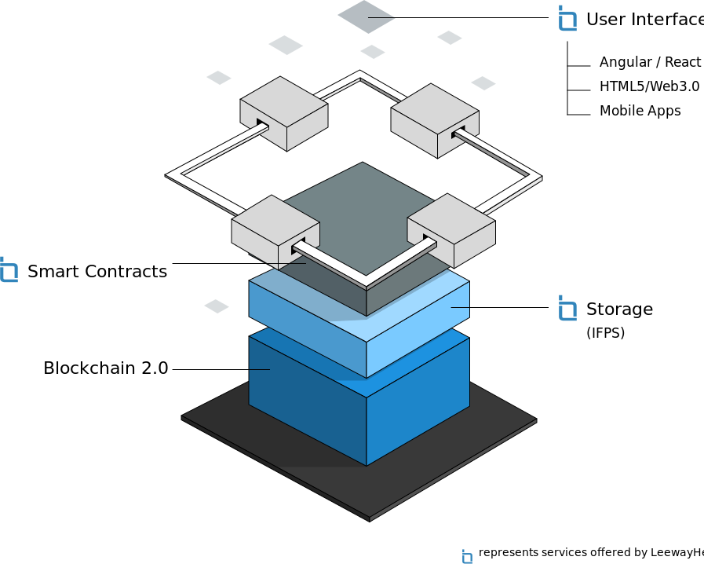
Decentralized Applications (DApp)
Applications where main functionality is implemented through SCs
Backend is executed in a decentralized environment
Frontend can be hosted as a web or mobile app
Interacts with its backend through an API
“State of the dapps” is a directory recorded on blockchain
https://www.stateofthedapps.com/
IPFS
Source: LeewayHertz
Notes:
Decentralised applications or DApps are applications where their main functionality is implemented through SCs
Backend is executed in a decentralised environment like BC. As seen on the figure, even its storage may be decentralised. For e.g., IPFS which stands for Inter-Planetary File System, a P2P storage solution
The frontend can be hosted as a web or mobile app. It interacts with its backend through an API
“State of the dapps” is a directory of DApps recorded on BC
It’s important to understand that while DApps rely on SCs, not all SCs belongs to a DApps

Slide 42

Fungible & Non-fungible Tokens
Fungible tokens
Identical & interchangeable
E.g., $2 coin, $10 note
Can be split
Main concern: how many?
Ethereum ERC-20 standard
https://theethereum.wiki/w/index.php/ERC20_Token_Standard
Lots of cryptocurrencies are offered on-top of Ethereum as ERC-20 tokens
Non-fungible tokens
Unique
E.g., houses, art, patents
Can’t be split
Main concern: which ones?
Ethereum ERC-721
https://github.com/ethereum/EIPs/issues/721
E.g., cryptokitties https://www.cryptokitties.co/
Kitties are non-fungible, individual, & their appearance depends on individual features
Notes:
Tokens represent some sort of ownership. In good old days, money notes represented the Gold maintained by Central/Reserve banks

Slide 43
Smart Contracts Best Practices
Follow the KISS principle: keep it simple, stupid
Make it readable/understandable, so other developers/technical users can start trusting into your code
Follow best practices, especially around security – there is no “safety net”
Interface of a SC isn’t visible from the deployed code
No requirement of the binary code to have a particular structure
But Solidity compiler establishes a particular structure
This structure needs to be known to the caller – i.e., a TX invoking a SC method must be aware of this structure & be constructed accordingly
Make the code available to potential users (e.g., open source), or at least the interface
Many interface standards proposed, e.g., ERC-20
Always look at online documentation
Solidity is under very active development & changes are frequent
Notes:
While SCs are essentially another price of code, you need to be careful as the code is visible to other exposing any potential vulnerabilities.
Also, there are minor differences in executing a code in a typical desktop vs on EVM due to differences in implementation. Such differences need to be thoroughly understood
Further, there’s no rollback if something goes wrong due to immutability of a BC. Hence, we need to be very careful
Following are some of the best practices:
Follow the KISS principle, where KISS stands for keep it simple, stupid
Also, make it readable/understandable, so other developers/technical users can start trusting into your code
Follow best practices, especially around security
While the interface or functions of a SC isn’t visible from the deployed code, and there’s no well-defined structure, Solidity compiler establishes a particular structure
This structure needs to be known to the caller of a function to properly format the TX
You may also want to make the code available to potential users (e.g., open-source), or at least the interface and there are several interface standards such as ERC-20 and ERC-721
Always look at online documentation as both Solidity and EVM is under rapid evolution

Slide 44
Question
Mark True or False for each the following statements about a Bitcoin & Ethereum
 | True | False
Immutability in both Bitcoin and Ethereum is probabilistic
Bitcoin uses account-balance model to keep track of assets while Ethereum uses UTXOs
Bitcoin TXs from the same account are ordered using a nonce
Even through a TX got included in a block, it may eventually get dropped
Compared to Bitcoin throughput of Ethereum is higher
✓
✓
✓
✓
✓
Notes:
The last question is tricky. To answer this question, we can do a rough calculation based on numbers in Slide 26. In the context of BCs, throughput is the no of TXs included in a block per second.
So, Ethereum can include a maximum of 475 TXs in a block. Assuming a block is built every 15 sec, throughput is 475/15 = 31.67
Bitcoin in average include 1500 TXs in a block. Assuming a block is built every 10 min, throughput is 1500/10*60 = 2.5
In practice, the throughput of Bitcoin is considered to be 3-7 TX/sec while it’s 15-25 per Ethereum

Slide 45
Hyperledger
Notes:
Next, we talk about Hyperledger, a BC designed specifically for private and consortium BCs

Slide 46



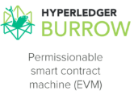

Hyperledger
Hyperledger is an umbrella project of a set of open source blockchains & related tools
Global collaboration, hosted by the Linux Foundation since Dec. 2015
Hyperledger Fabric is a business blockchain framework
Modular architecture
Configuration allows changing consensus algorithm
Private & permissioned blockchain
Smart contracts are called Chaincode – Go, node.js, or Java
No concept of TX fee
Can achieve much higher TX throughput with low latency
Notes:
Hyperledger is an umbrella project of a set of open-source blockchains & related tools
It’s hosted by the Linux Foundation with over 100 members
These are some of the BCs frameworks under Hyperledger
Hyperledger Fabric is a business blockchain framework intended as a foundation for developing blockchain-based applications
All Hyperledger frameworks are modular, e.g., In Fabric, you can change the consensus algorithm
Private & permissioned blockchain
SCs in Hyperledger are called Chaincode
No concept of TX fee
Can achieve much higher TX throughput with low latency. Under a well-optimised design, it’s possible to achieve about 100 TXs/sec

Slide 47
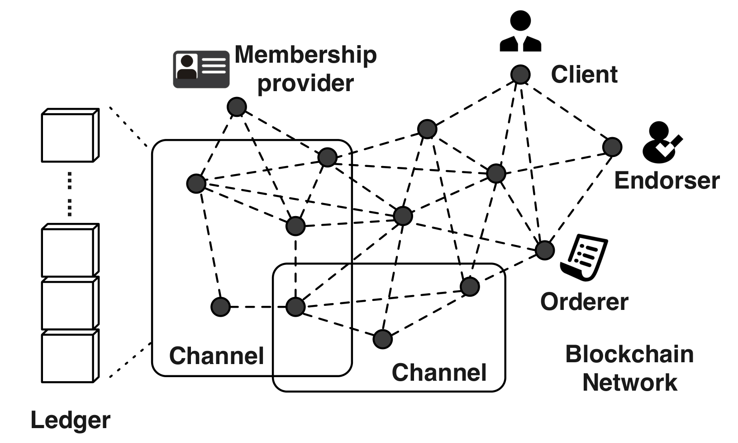
Hyperledger Fabric Network
Membership Service Provider (MSP)
All participants have known identities
Participants need to enrol
MSP is trusted
Public keys are used as cryptographic certificates tied to organisations, network components, & end users
Channels
Data access control is applied on network & channel levels
Built for scenarios where privacy & confidentiality are important → reduced transparency is acceptable
Allow a group of members to create a separate ledger, shared only with that group
Notes:
Hyperledger Fabric Network has a set of components
These are the clients. They need pre-authorisation form a special service called the Membership Service Provider (MSP).
All participants have known identities, and they need to enrol with the MSP
MSP which is trusted by all the participants
Public keys are used as cryptographic certificates tied to organisations, network components, & end-users
In addition to enforcing participation at network-level, it can be further groups as a set of channels
Channels are like subnetworks within the main network
Channels are built for scenarios where privacy & confidentiality are important --> reduced transparency is acceptable
Hence, a channel allows a group of members to create a separate ledger, shared only with that group
Let’s talk about clients, orderer, and endorsers in the next slide

Slide 48
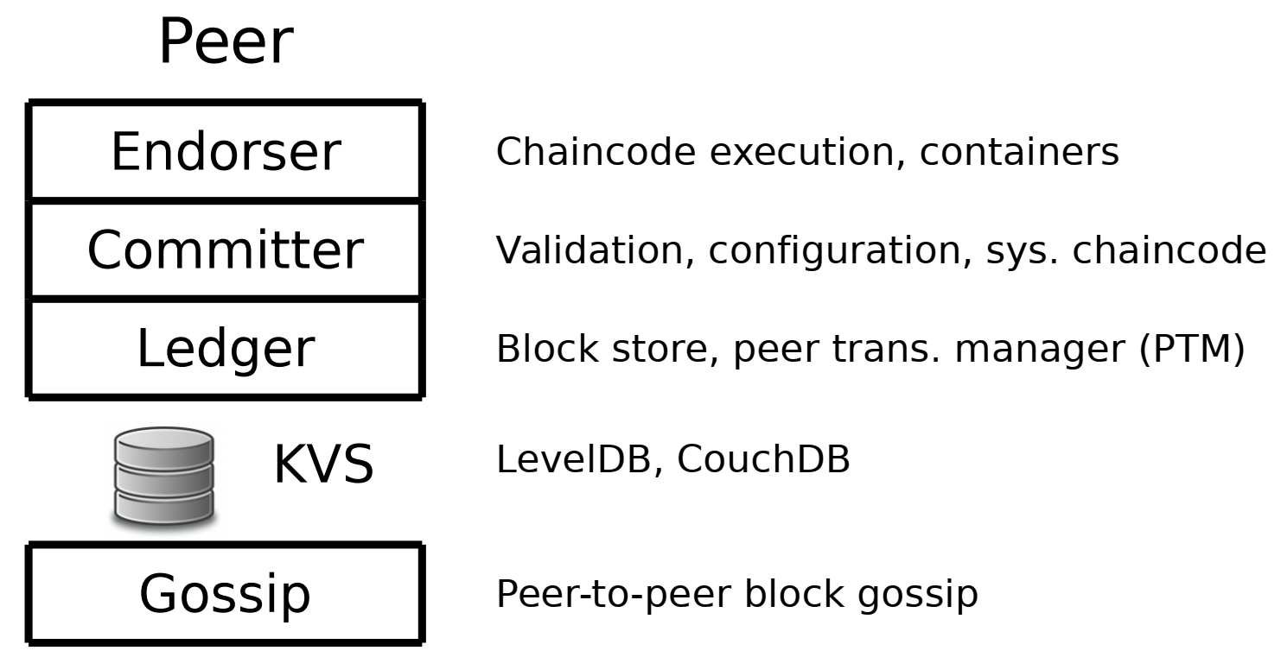
Hyperledger Fabric Node Types
Client
A client connects to peers to communicate with blockchain on behalf of an end user
Can create & send TXs, & observe updates
Can connect to (multiple) channels, but is unaware of other existing channels
Orderer
Validates & orders TXs into a sequence, then broadcasts them to the network
Provides a communication channels between clients & peers
Set of orderers could be used to support multiple channels & achieve high availability
Peer
Receives ordered TXs from the orderer, commits TXs, & maintains the state
Can play a special role like endorser
Every TX invoking chaincode needs to be endorsed before being committed
Chaincode can specify an endorsement policy that defines the conditions for valid TX endorsement
Notes:
A client is like a wallet and connects to peers in the Hyperledger network to communicate on behalf of an end user
It can be used to create & send TXs, as well as observe updates
A client may connect to multiple channels, but is unaware of other existing channels that it’s not part of
As the name implies, Orderer orders TXs within Hyperledger network creating a global order of TXs
It validates & orders TXs into a sequence, then broadcasts them to the network
Provides a communication channel between clients & peers
Set of orderers could be used to support multiple channels & achieve high availability
Peers are the nodes of the BC network.
A peer receives ordered TXs from the orderer, commits TXs, & maintains the ledger state
Can play a special role like endorser. In Hyperledger every TX invoking chaincode needs to be endorsed before being committed
Therefore, before submitting a TX, it needs to be endorsed by one or more endorsers, who will run the chaincode and verify that the TX is valid
Chaincode can specify an endorsement policy that defines the conditions for valid TX endorsement
What we see in this figure is the different layers of a peer. Ledger is maintained as a key-value database. Hyperledger supports both LevelDB & CouchDB

Slide 49
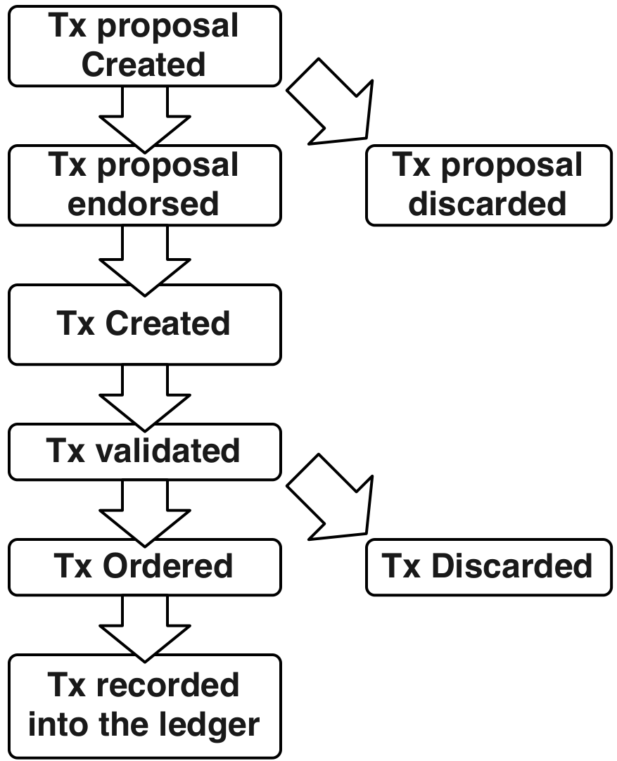
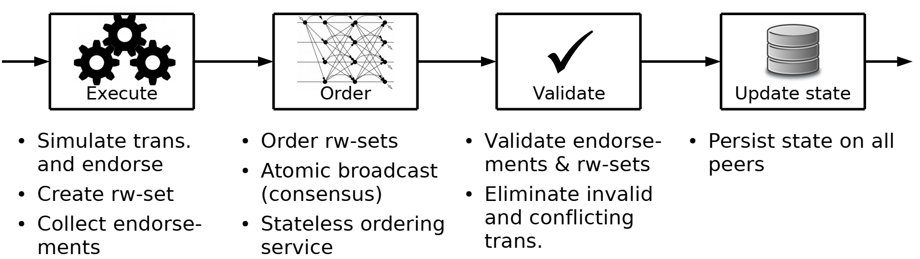
Hyperledger Fabric Transaction Lifecycle
Recommends Raft - Leader-based, Crash Fault Tolerant (CFT) consensus algorithm
Notes:
These figures illustrate the lifecycle of a TX in Hyperledger
First, the client creates a TX proposal and then submitted that to 1 or more endorsers
If valid, a TX is created with the signature of endorsers. Else, it’s discarded
Once a TX reaches the orderer, it validates the endorsement based on the pre-defined policy. If valid TX is ordered and broadcasted to all peers. Else, it’s dropped
Finally, the TX is recorded in the ledger
Here’s another way of looking into this process.
First, the TX is executed on endorsers.
Then the read and write set is created. This captures the current state on ledger related to the chaincode, and resulting state after executing the chaincode
If there’s more than one endorser, all endorsements are collected and then send to orderer
It orders TXs (which essentially mean ordering their read-write set) and builds a block. Then broadcasts the block to all peers
Orderer is stateless and just orders TXs as it wish
Once a TX is received, peers validate the endorsement & read-write set of a TX.
If it’s invalid or ledger state is changed between the collection of read-write set and validation, it’s dropped. This could happen due to concurrent TXs
Finally, the ledger is updated

Slide 50
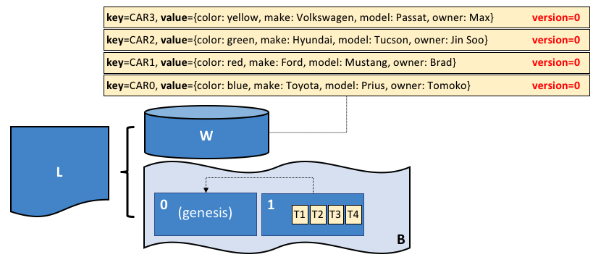
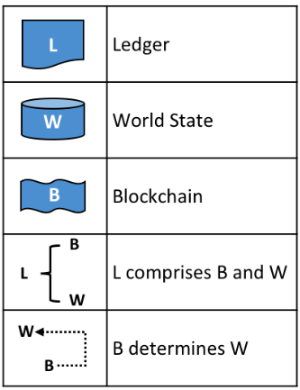
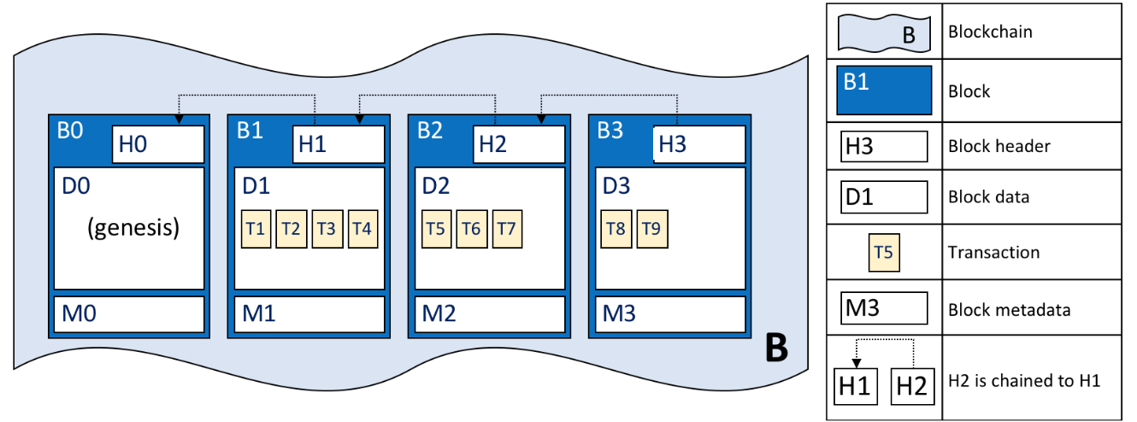
Hyperledger Fabric Transactions & Block Format
Source: https://hyperledger-fabric.readthedocs.io/en/release-2.0/ledger/ledger.html
Notes:
Block format in Hyperledger is similar to other BCs. Only difference is there’s no nonce as order decides what TXs go into a block and order of blocks. Hence, as soon a TX is included in a block and it’s executed by the peers, TX is finalised
Similar to Ethereum, Hyperledger also maintains account and their balances as World state. Here keys are like accounts and values are the state

Slide 51
Question
Which of the following statement(s) is True?
As Hyperledger uses a Membership Service Provider (MSP), it’s not required to sign TXs
Consensus algorithm in Hyperledger Fabric is based on PoW
Both Ethereum & Hyperledger Fabric maintain World State as a set of accounts & balances
Finality (i.e., time to confirm a TX) in Hyperledger Fabric is immediate
X
X
✓
✓
Notes:
In this lecture, we talked about hashing, Merkel trees, and public-key cryptography. Hashing is useful to derive a TX and block hash. Merkel tree is helpful to summarise the set of TXs in a block & world state. The private key is used to sign TXs while the address of an account is derived from the public key
Then we discussed Bitcoin, Ethereum, & Hyperledger. Bitcoin and Ethereum use PoW while

Slide 52
Course Outline – Next 2 Weeks
Week | Date | Lecturer | Lecture Topic | Relevant Book Chapters | Notes
2 | June 10 & 11 | Sherry | Software Architecture Basics Blockchain in Software Architecture Blockchain Taxonomy 1/2 | 5. Blockchain in Software Architecture
3 | June 17 & 18 | Sherry | Blockchain Taxonomy 2/2 Blockchain Application Design Process Blockchain Suitability Evaluation Guest lecture |  | Project 1 submission Project 2 Task 1

